Slide 1

Programming Concepts
Python (Conditions and Loops)
Session 4
Instructor: Ms. Laraib

Slide 2
Learning Objectives
Decision making with conditions
Logical Operator
Conditional Operator
Use loops to repeat tasks
2

Slide 3
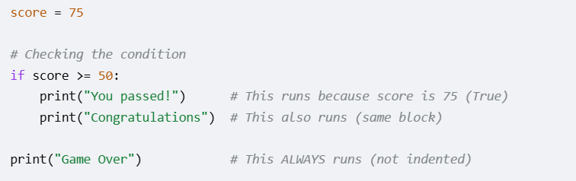
Decision Making
Programs can choose what to do
The Choice: If a condition is True, the code runs. If it is False, Python skips it.
The Spaces (Indentation): You must indent (add spaces) to show which lines belong to that choice.
19

Slide 4
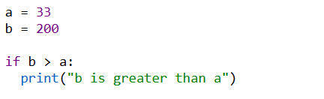
The if Statement
if is used to make a decision based on a condition.
An "if statement" is written by using the if keyword.
The condition is checked to see if it is True.
20

Slide 5

Working of if statement
The if statement evaluates a condition (an expression that results in True or False).
If the condition is true, the code block inside the if statement is executed.
If the condition is false, the code block is skipped.
The indented code runs only when the condition is True.
Indented code means code that has spaces at the beginning of the line.

Slide 6
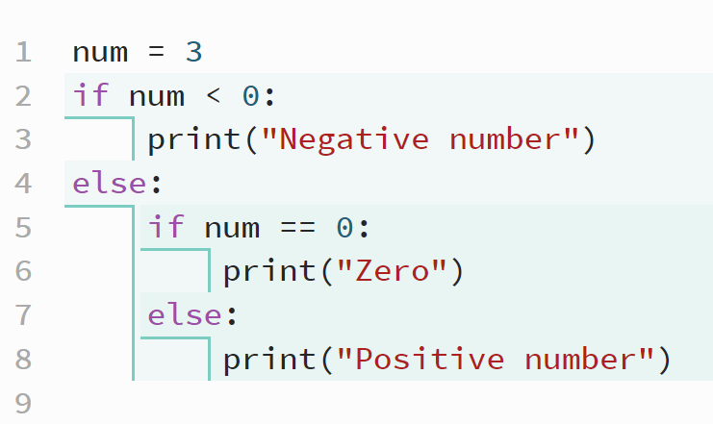
Indentation
Indentation in Python is not just for code readability, it is a fundamental syntax requirement. While languages like C, C++, and Java use curlay braces {} to define a block of code, Python uses leading whitespace.
4 spaces per indentation

Slide 7
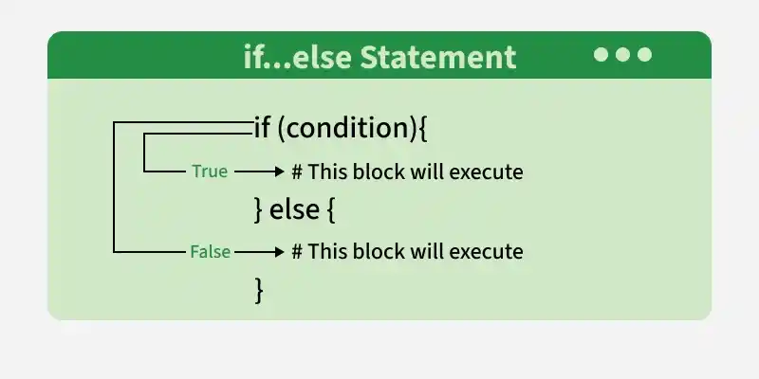
If-else condition
An if-else statement gives your program two clear paths: a True path and a False path.
How it Works
if: Runs its code only if the condition is True.
else: Runs its code automatically if the condition is False.
Example:
marks = 45
if marks >= 50:
print("Pass")
else:
print("Fail")
21

Slide 8
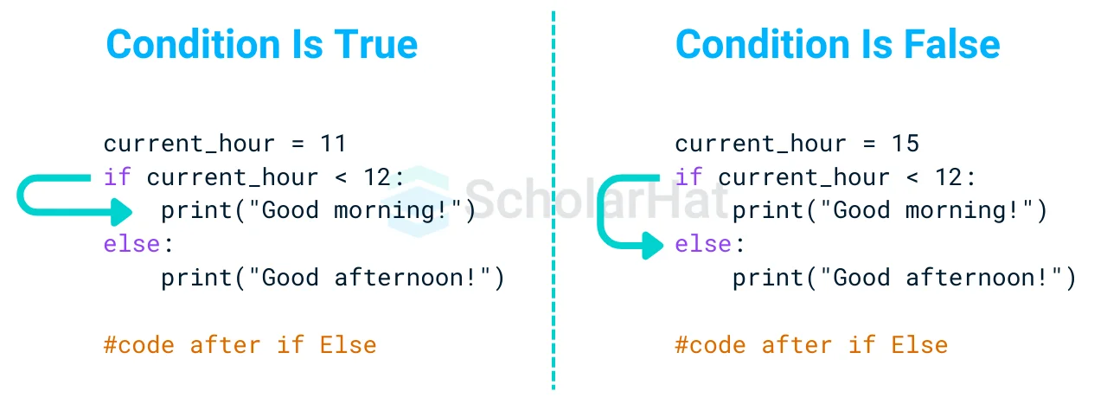
Working of if-else condition

Slide 9
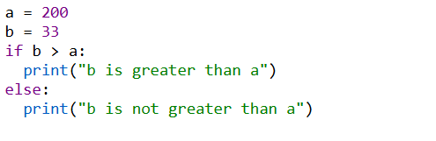
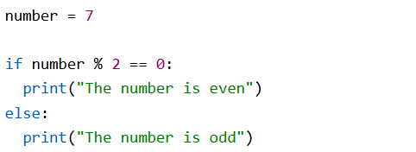
If-else example
Example: Checking number is greater or not
Example: Checking even or odd numbers:

Slide 10
elif: Multiple Choices
The Elif Keyword
elif keyword means: "if the previous conditions were not true, then try this condition".
The elif keyword allows you to check multiple expressions for True and execute a block of code as soon as one of the conditions evaluates to True.
When you use elif, Python evaluates the conditions from top to bottom. As soon as it finds a condition that is true, it executes that block and skips all remaining conditions.
22

Slide 11
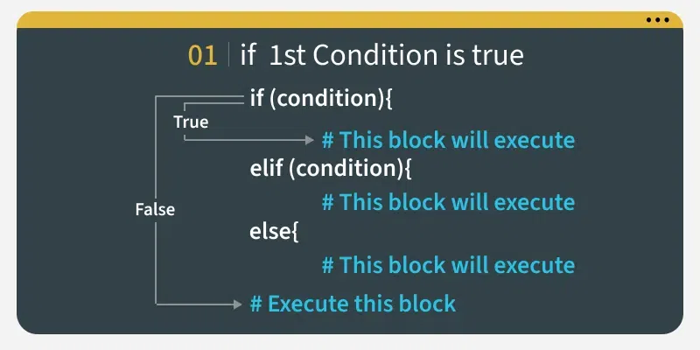
elif: Multiple Choices
An elif statement allows you to check multiple conditions in a row. It is short for "else if".
Example:
marks = 75
if marks >= 80:
grade = "A"
elif marks >= 70:
grade = "B"
elif marks >= 60:
grade = "C"
else:
grade = "Fail"
print(grade)
22

Slide 12
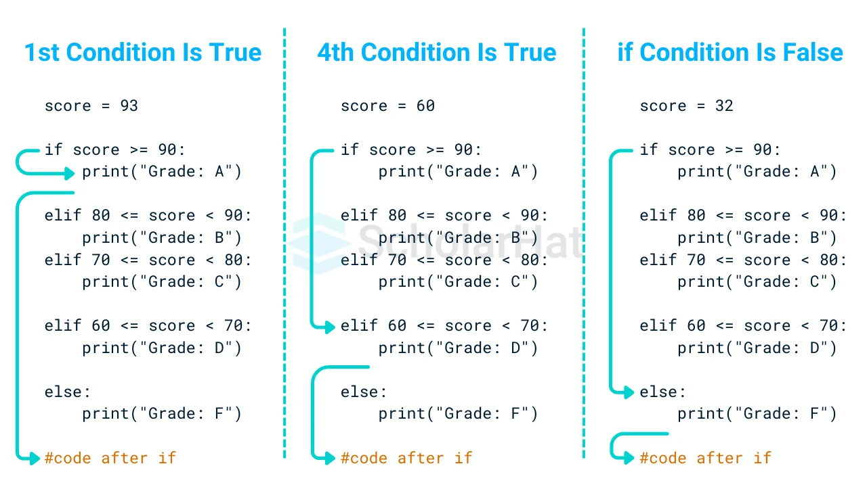
Working of elif
22

Slide 13
Comparison Operators
Equals: a == b
Not Equals: a != b
Less than: a < b
Less than or equal to: a <= b
Greater than: a > b
Greater than or equal to: a >= b
These conditions can be used in several ways, most commonly in "if statements" and loops.

Slide 14
Logical operators
Logical operators are used to combine conditional statements. Python has three logical operators:
  AND- Returns True if both statements are true
  OR - Returns True if one of the statements is true
  NOT - Reverses the result, returns False if the result is true

Slide 15
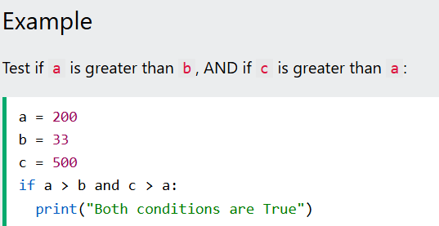

AND operator
The and keyword is a logical operator, and is used to combine conditional statements. Both conditions must be true for the entire expression to be true.

Slide 16
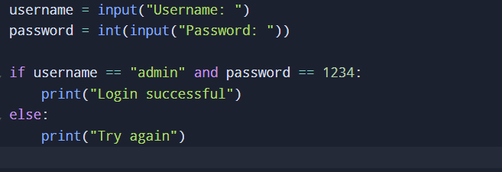
And Operator Activity - Login System
• Ask for username
• Ask for password
•Check condition
25

Slide 17
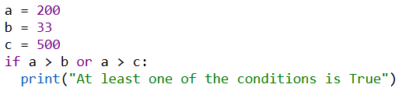
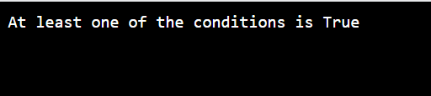
OR operator
The or keyword is a logical operator, and is used to combine conditional statements. At least one condition must be true for the entire expression to be true.

Slide 18
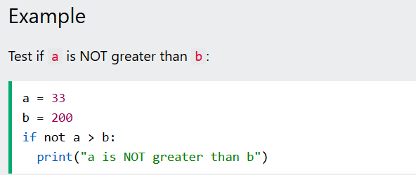

not Operator
The not keyword is a logical operator, and is used to reverse the result of the conditional statement.

Slide 19
Why Loops?
Repetition is common in programs → Sometimes we need to perform the same task multiple times.
Loops reduce repeated code → Instead of writing the same code again and again, we use a loop.
Choose for when repetitions are known → Use a for loop when you know how many times you want to repeat something.
26

Slide 20
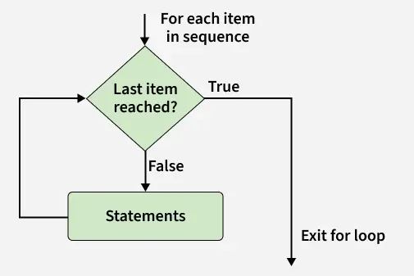
for Loop
Repeat a known number of times
The for loop in Python is a control flow statement used to repeat a block of code for a fixed number of times.
For loop in Python designed to iterate over a sequence, like a list, tuple, string, or range, and other iterable objects.
27

Slide 21
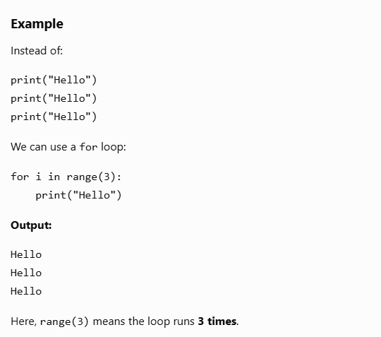
for Loop Examples
27

Slide 22
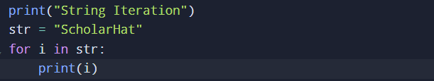
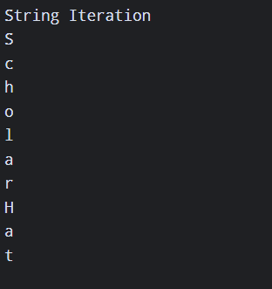
for Loop
Code:
Output:
27

Slide 23
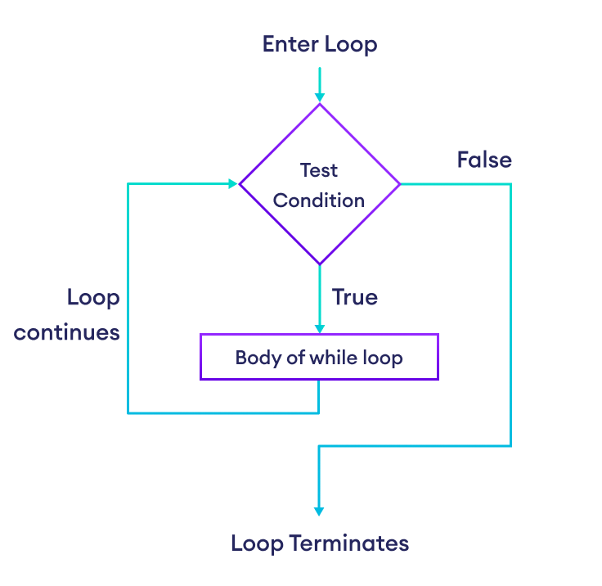
while Loop
A while loop repeats code as long as a condition is True.
A while loop in Python is used to repeat a block of code as long as a certain condition is true.
It keeps running the loop body again and again until the condition becomes false.
count = 1
while count <= 5:
print(count)
count = count + 1
28

Slide 24
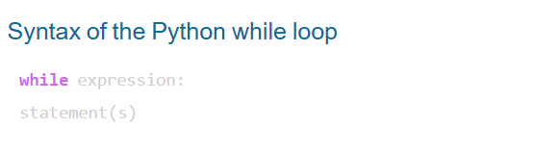
while Loop
count = 1
while count <= 5:
print(count)
count = count + 1
count = 1
while count <= 5:
print(count)
count = count + 1
28

Slide 25
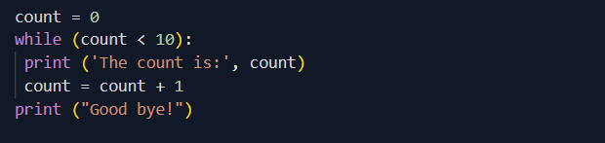
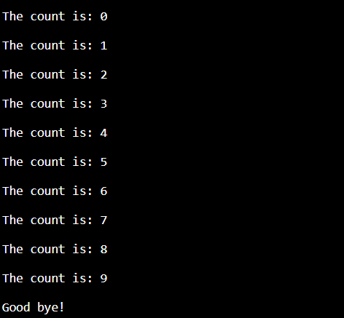
while Loop
count = 1
while count <= 5:
print(count)
count = count + 1
28

Slide 26
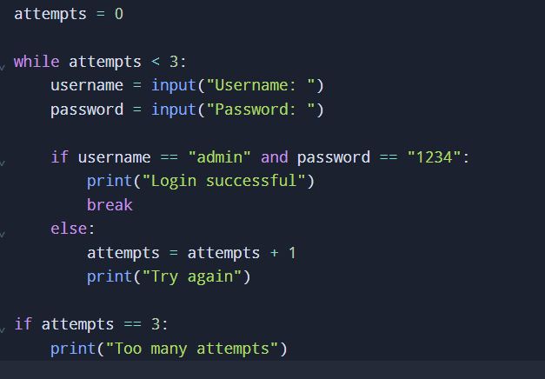
while Loop
Write a Python program that asks the user to enter a username and password.
The correct username is "admin".
The correct password is "1234".
Use the and logical operator to check that both username and password are correct.
If both are correct, display "Login successful".
If the login details are incorrect, display "Try again".
The user should be given a maximum of 3 login attempts.
After 3 incorrect attempts, display "Too many attempts" and stop the program.
28

Slide 27
Debugging Challenge
Find and fix the loop problem
• Find the missing update
• Explain why the loop stops or continues
• Fix the code
count = 1
while count <= 5:
print(count)
# What is missing?
29

Slide 28
Class Activity
Write a Python program that:
Ask the user to enter a number.
Use an if-elif-else statement to check whether the number is:
  Positive
  Negative
  Zero
Use a while loop to keep asking the user for a number.
Stop the loop when the user enters 0.
When 0 is entered, print "Program ended".
30

